Slide 1
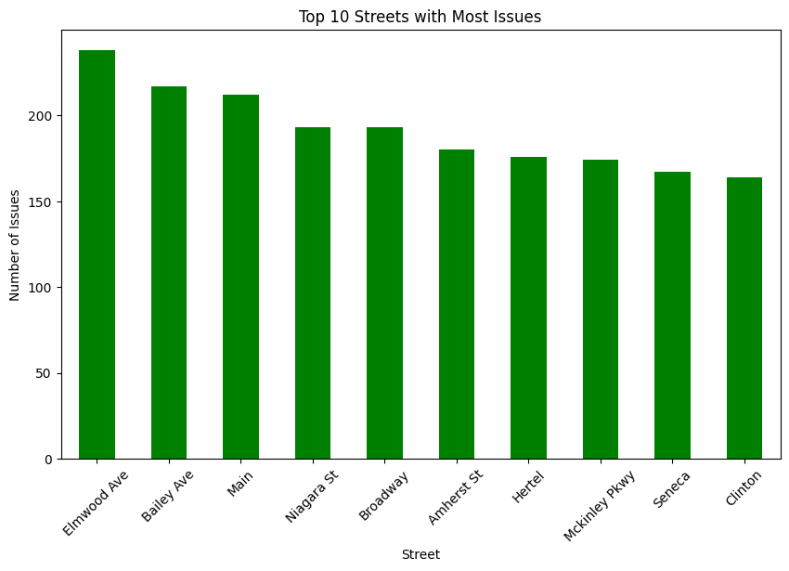
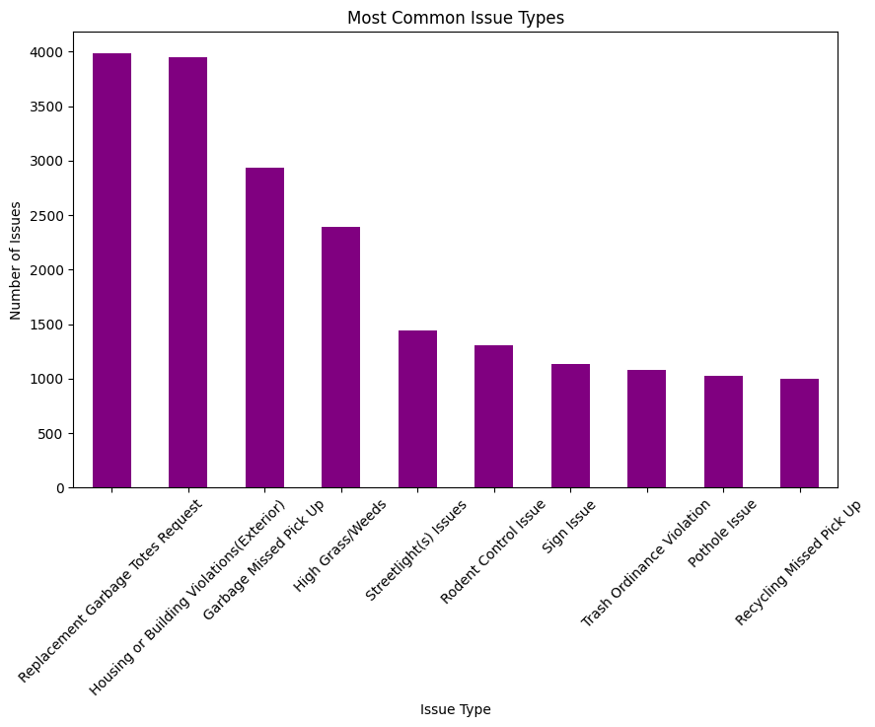
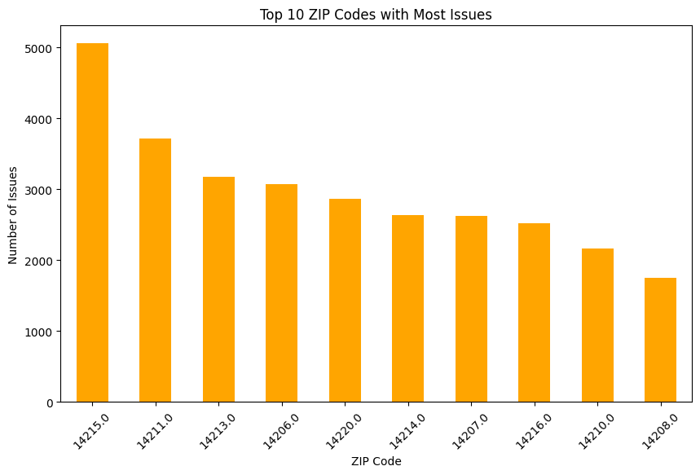
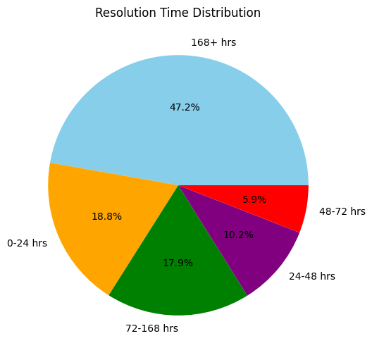
Buffalo 311 Service Analysis: Most Reported Issues
Saim Mahmud, Computer Information System · Dr, Sarbani Banerjee, CIS Department
Introduction
Interpretation of findings
This project is about analyzing 311 service requests in Buffalo. These requests are made by residents to report problems like broken streetlights or missed garbage pickups. The goal of this analysis is to find the most common problems, the ZIP codes and streets with the most issues, and other useful patterns.
The analysis revealed that the most reported issues were “Replacing Garbage Tote Requests” and “Housing ot Building Violations(Exterior).” ZIP code 14215 had the most complaints, followed by 14211 and 14213, Streets like “Elmwood Ave” amd “Main St” reported the most issues These findings highlight patterns in service requests across Buffalo.
Background
Buffalo residents use the 311 system to report non-emergency problems. These reports help the city fix issues like damaged roads, streetlights, or trash pickup delays. By studying this data, we can see which problems happen the most and where they are reported the most often. This helps the city improve its services and plan better.
Conclusion
This project helped to identify the most common issues reported in Buffalo and the areas most affected. The findings can assist city officials in focusing on key problem areas to improve services and address community concerns effectively.
Methodology
For this project, I used Python with libraries like Pandas for date manipulation, Matplotlib and Seaborn for creating graphs, and NumPy for numerical calculations. First, I cleaned the data by handling missing values. Replacing missing Closed Date entries with “Unresolved” and removing rows with missing Street or Zip values. Finally, I analyzed the data to identify the most common issue types, ZIP codes, and streets with the highest Number of reported problems, using visualizations to present the results clearly.
Reference
W3school https://www.w3schools.com/python/matplotlib_intro.asp
Google Collab
https://colab.research.google.com/
3) Youtube tutorial for Making bar charts
https://www.youtube.com/watch?v=9VK8quGFcSE
4) Open Data City Buffalo.
https://data.buffalony.gov/

